Slide 1
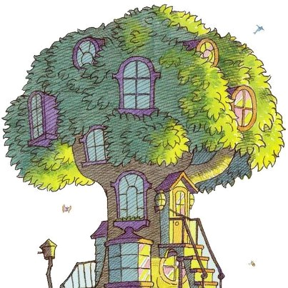
Berenstain Bear Slideshow
By: Nikki and Lisa

Slide 2
Who wrote and illustrated the Berenstain Bears?
Stan and Jan Berenstain
Both were the authors and illustrators

Slide 3
How did the Co-Authors meet?
Stanley and Janice met in 1941 on the first day of drawing class at Philadelphia Museum School of Industrial Art
Stan and Jan formed an immediate bond
The two married in 1946

Slide 4
What was the first book the couple wrote together?
The Big Honey Hunt
The book was written in 1962

Slide 5
What did they write about?
Teaches a lesson in everyday settings
Easily relatable
Funny stories
Over 200 different titles

Slide 6
Berenstain Bears Theme Song

Slide 7
Sources
http://childrensbooks.about.com/od/authorsillustrato/a/berenstainbears_2.htm
http://www.youtube.com/watch?v=oJKpcfm1qD4
http://en.wikipedia.org/wiki/The_Big_Honey_Hunt
http://en.wikipedia.org/wiki/Stan_and_Jan_Berenstain
http://en.wikipedia.org/wiki/Berenstain_Bears

